Slide 1

Model to Predict Churn in Syriatel

Slide 2

Objective
Develop a statistical model to predict Churn

Slide 3
Introduction - EDA

Slide 4
Process

Slide 5
Model Effectiveness
Model | Train_Score | Test_Score | CV | Precision | Recall | Accuracy | F1_Score
Dummy Model | 0.8567 | 0.8501 | 0.0000 | 0.00 | 0.00 | 0.85 | 0.00
Logistic Regression | 0.7775 | 0.7842 | 0.4561 | 0.39 | 0.79 | 0.78 | 0.52
Log with Poly Feature | 0.8567 | 0.8561 | 0.5555 | 0.51 | 0.79 | 0.86 | 0.62
gs model | 0.9076 | 0.8873 | 0.5555 | 0.60 | 0.75 | 0.89 | 0.67

Slide 6
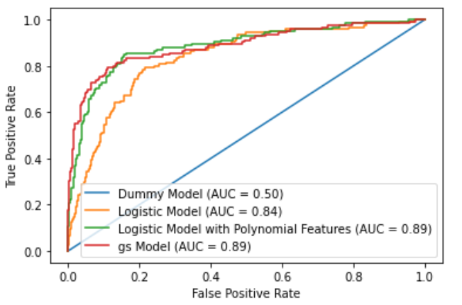
ROC curve

Slide 7
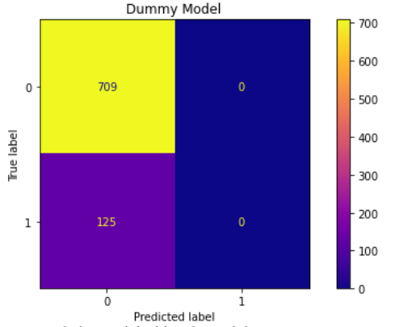
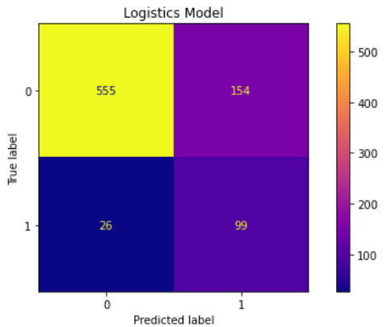
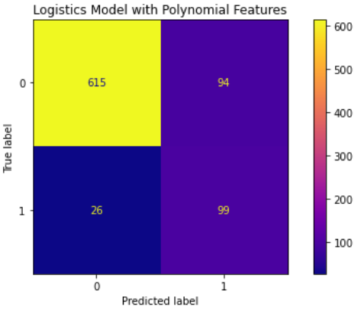
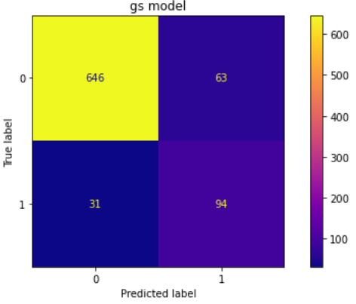

Confusion Matrix
125
180
F-Score 0
F-Score 0.52
120
94
F-Score 0.62
F-Score 0.67

Slide 8

Recommendation
Logistic Regression Model with Polynomial Feature
Imputer strategy : mean
Degree of Polynomial :3
C = 1
Solver = liblinear
Tolerance : 0.001
No of iterations = 100

Slide 9

Next steps
Validate the model using expanded data set
Use other classification models
Implement the model in user friendly environment

Slide 10

Thank You

